Slide 1





“Growin’Up” a Mobile Application for primary students with Dyslexia to improve Sinhala language.
Project ID : TMP-23-034

Slide 2
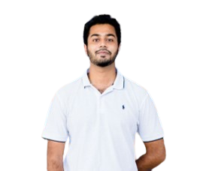
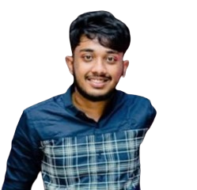
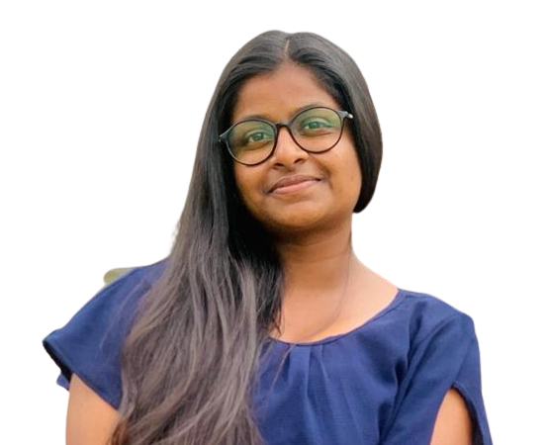
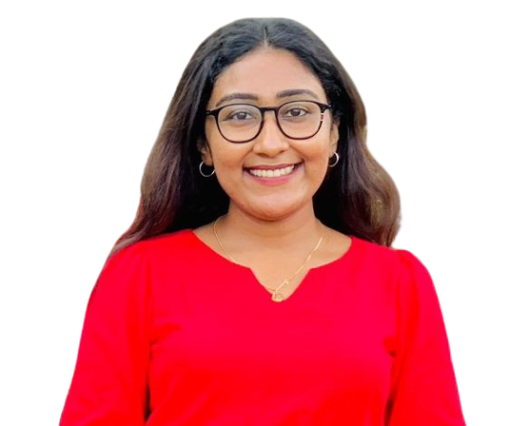
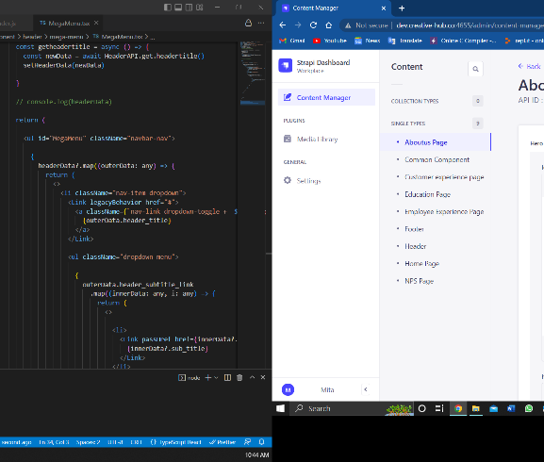

Meet our team
Group Leader Meddaduwage P.M
Member 03 Liyanage L.T.N
Member 04 E.N.D.S. Elamaldeniya
Member 02 Sandeepa U.H.A.N

Slide 3


YOU WILL BE TAKEN THROUGH
Introduction
Research Problem
Research Objectives
Overall System Diagram
Individual Components
Gantt Chart
Budget
Appendix

Slide 4

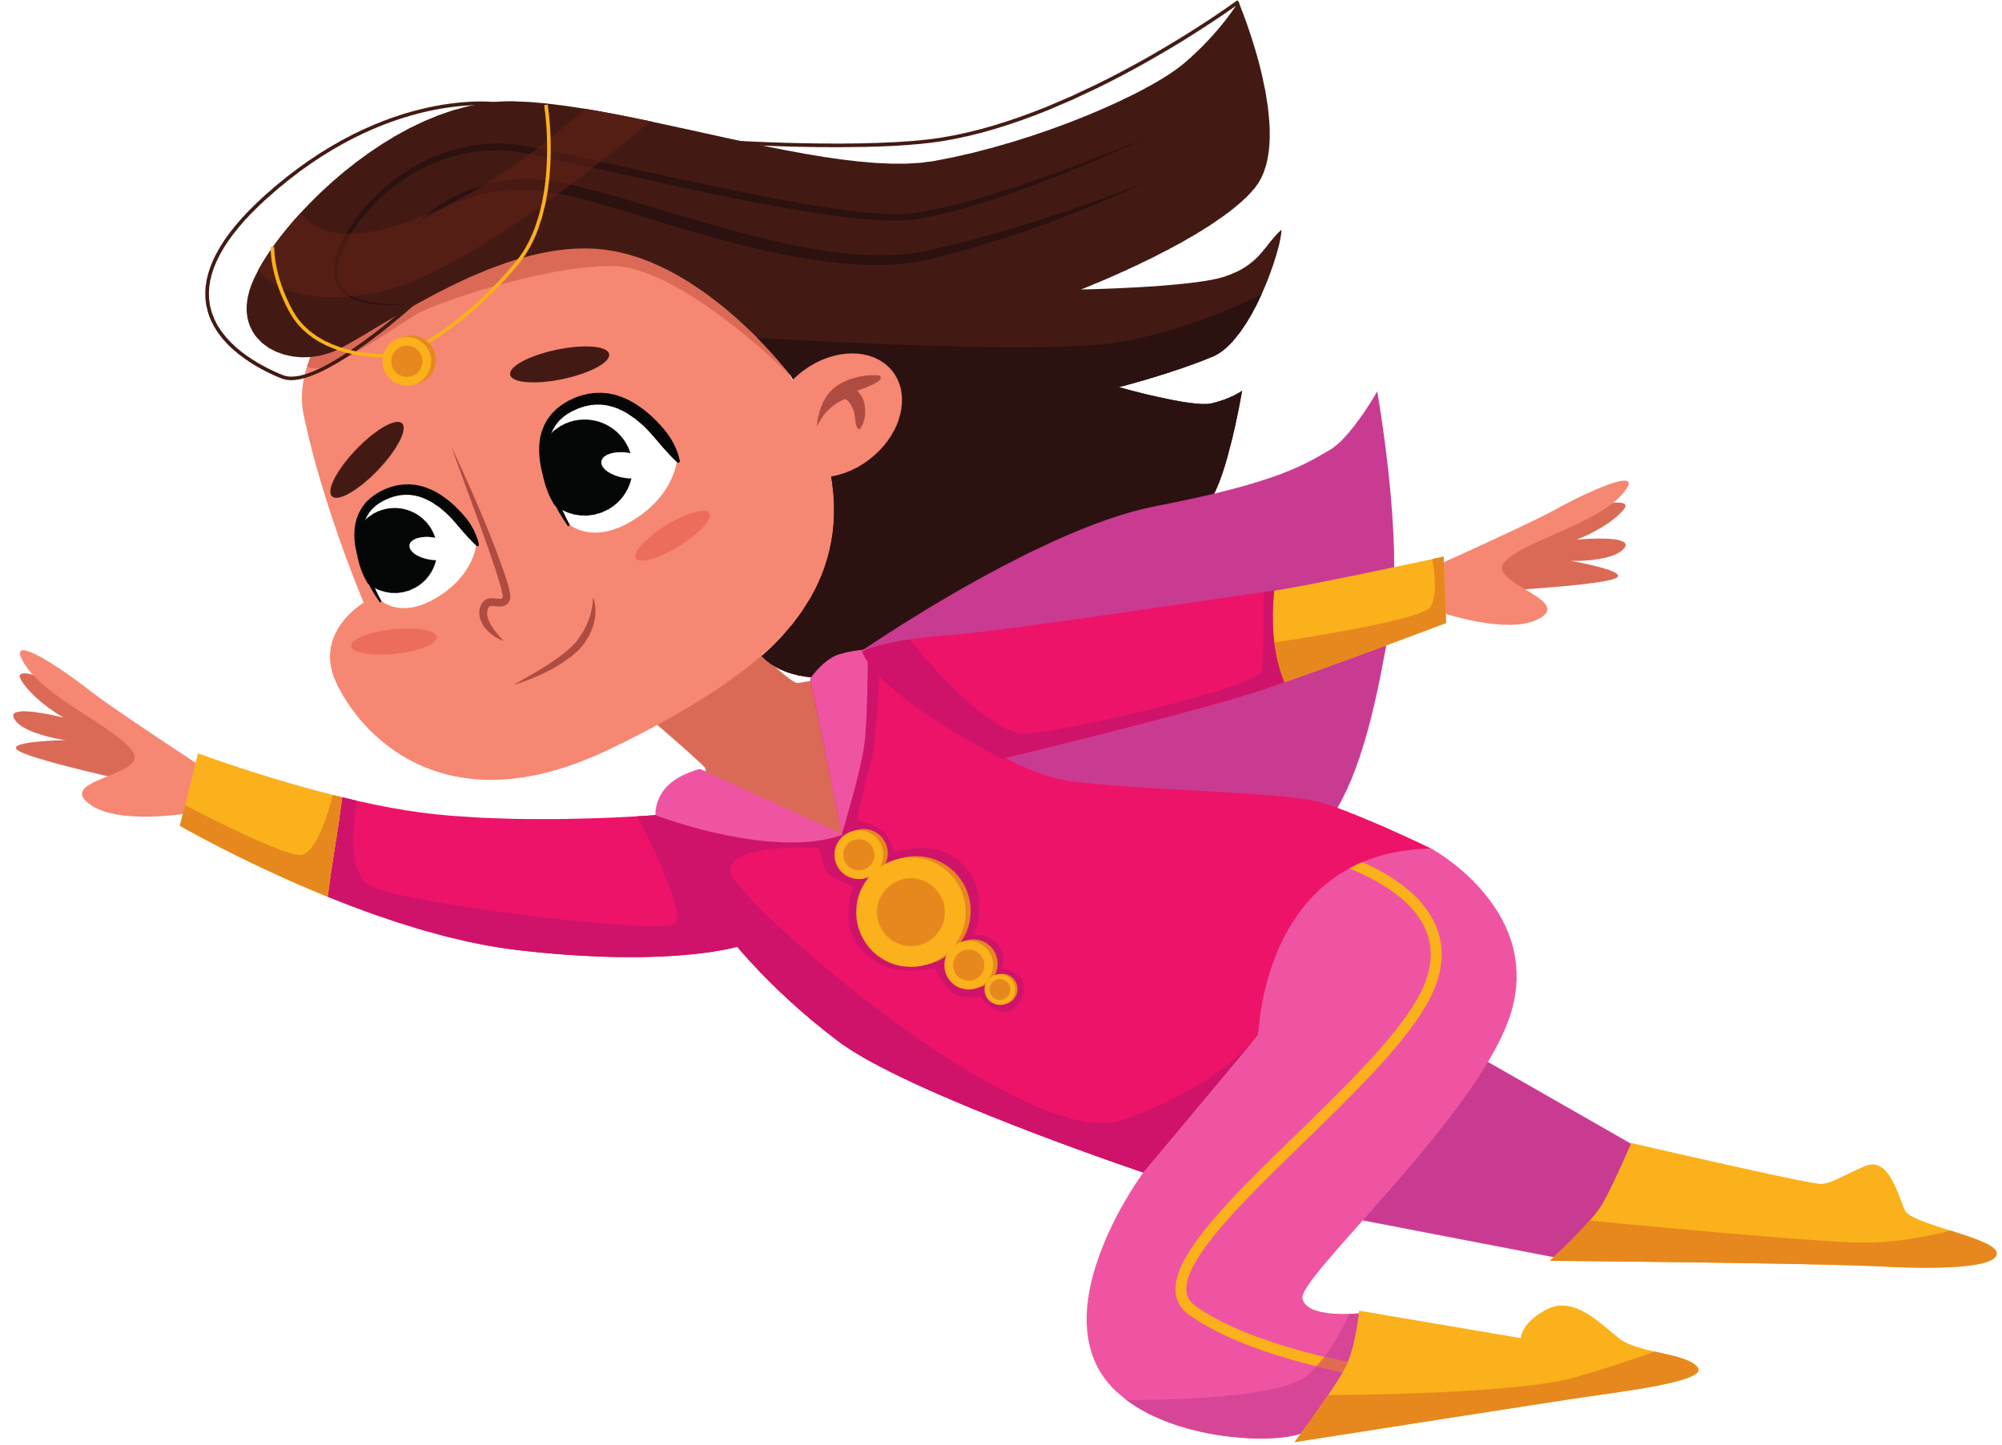
introduction
Focuses on improving language learning for primary students with dyslexia through the use of a mobile application called "Growin'Up".
Dyslexia can be especially challenging for children who are still learning their native language.
Develop a mobile application that will help primary students with dyslexia improve their Sinhala language skills.
This presentation will cover the development and design process of the "Growin'Up" mobile application.

Slide 5

INTRODUCTION CONTINUED
What is Dyslexia ?
A neurological disorder that affects a person's ability to read, write, and spell.
People with dyslexia may have average or above-average intelligence.
A challenge for individuals to comprehend written material, and it can also impact their writing abilities.
With the right support and interventions, individuals with dyslexia can develop strong reading and writing skills and achieve their full potential.

Slide 6
RESEARCH PROBLEM
Primary students with dyslexia face challenges in learning their native language, Sinhala.
Traditional teaching methods may not be effective for these students.
A mobile application that is specifically designed to cater to the learning needs of primary students with dyslexia.
The development and effectiveness of such an application need to be researched and evaluated to ensure that it is a useful and impactful tool for these students.

Slide 7
RESEARCH OBJECTIVES
Design and develop a mobile application called "Growin'Up" for primary students with dyslexia to improve their Sinhala language skills.
Investigate the potential impact of the "Growin'Up" mobile application on the learning outcomes and self-efficacy.
Identify the specific features and accommodations that are most effective in supporting the learning needs.

Slide 8

OBJECTIVES CONTINUED
WHAT WILL BE FOUCESD?
1
Analyzing sequential difficulties faced by the kids of the age limit of 6-8.
2
Effects of phonological dyslexia, when learning letters, spellings and their sounds.
3
Identifying the number learning difficulties faced by the dyslexic students.
4
Researching on rapid naming dyslexia and focusing on reading disabilities faced by dyslexic students.

Slide 9
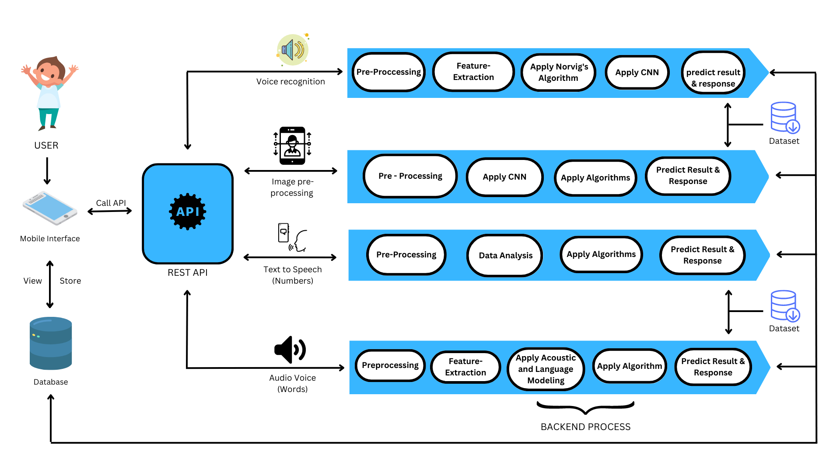
OVERALL SYSTEM DIAGRAM

Slide 10
INDIVIDUAL COMPONENTS

Slide 11
IT20127428
Meddaduwage P.M
BSc(Hons) in Information Technology Specializing in Information Technology
IT20127428 | Meddaduwage P.M | TMP-23-034

Slide 12

COMPONENT 01
Analyzing sequential difficulties faced by the kids of the age limit of 6-8 and the impact of visual dyslexia and providing solutions to overcome them.
IT20127428 | Meddaduwage P.M | TMP-23-034

Slide 13
WHAT is Sequential Difficulties in Dyslexia?
Difficulty with recognizing and remembering the order of letters and words, sequencing sounds.
Cause problems in remembering the sequence of steps needed to complete a task.
Difficulties can affect visual processing, which causes confusions with similar words.
Also affects auditory processing, with sounds being mis-sequenced.
IT20127428 | Meddaduwage P.M | TMP-23-034

Slide 14
Research problem
Identify What are the sequential difficulties faced by children aged 6-8 with visual dyslexia ?
what is the impact of these difficulties on their academic performance?
what are the most effective interventions and strategies for overcoming these difficulties and improving academic outcomes for these children?
Can a mobile application help them to overcome this problem?
IT20127428 | Meddaduwage P.M | TMP-23-034

Slide 15
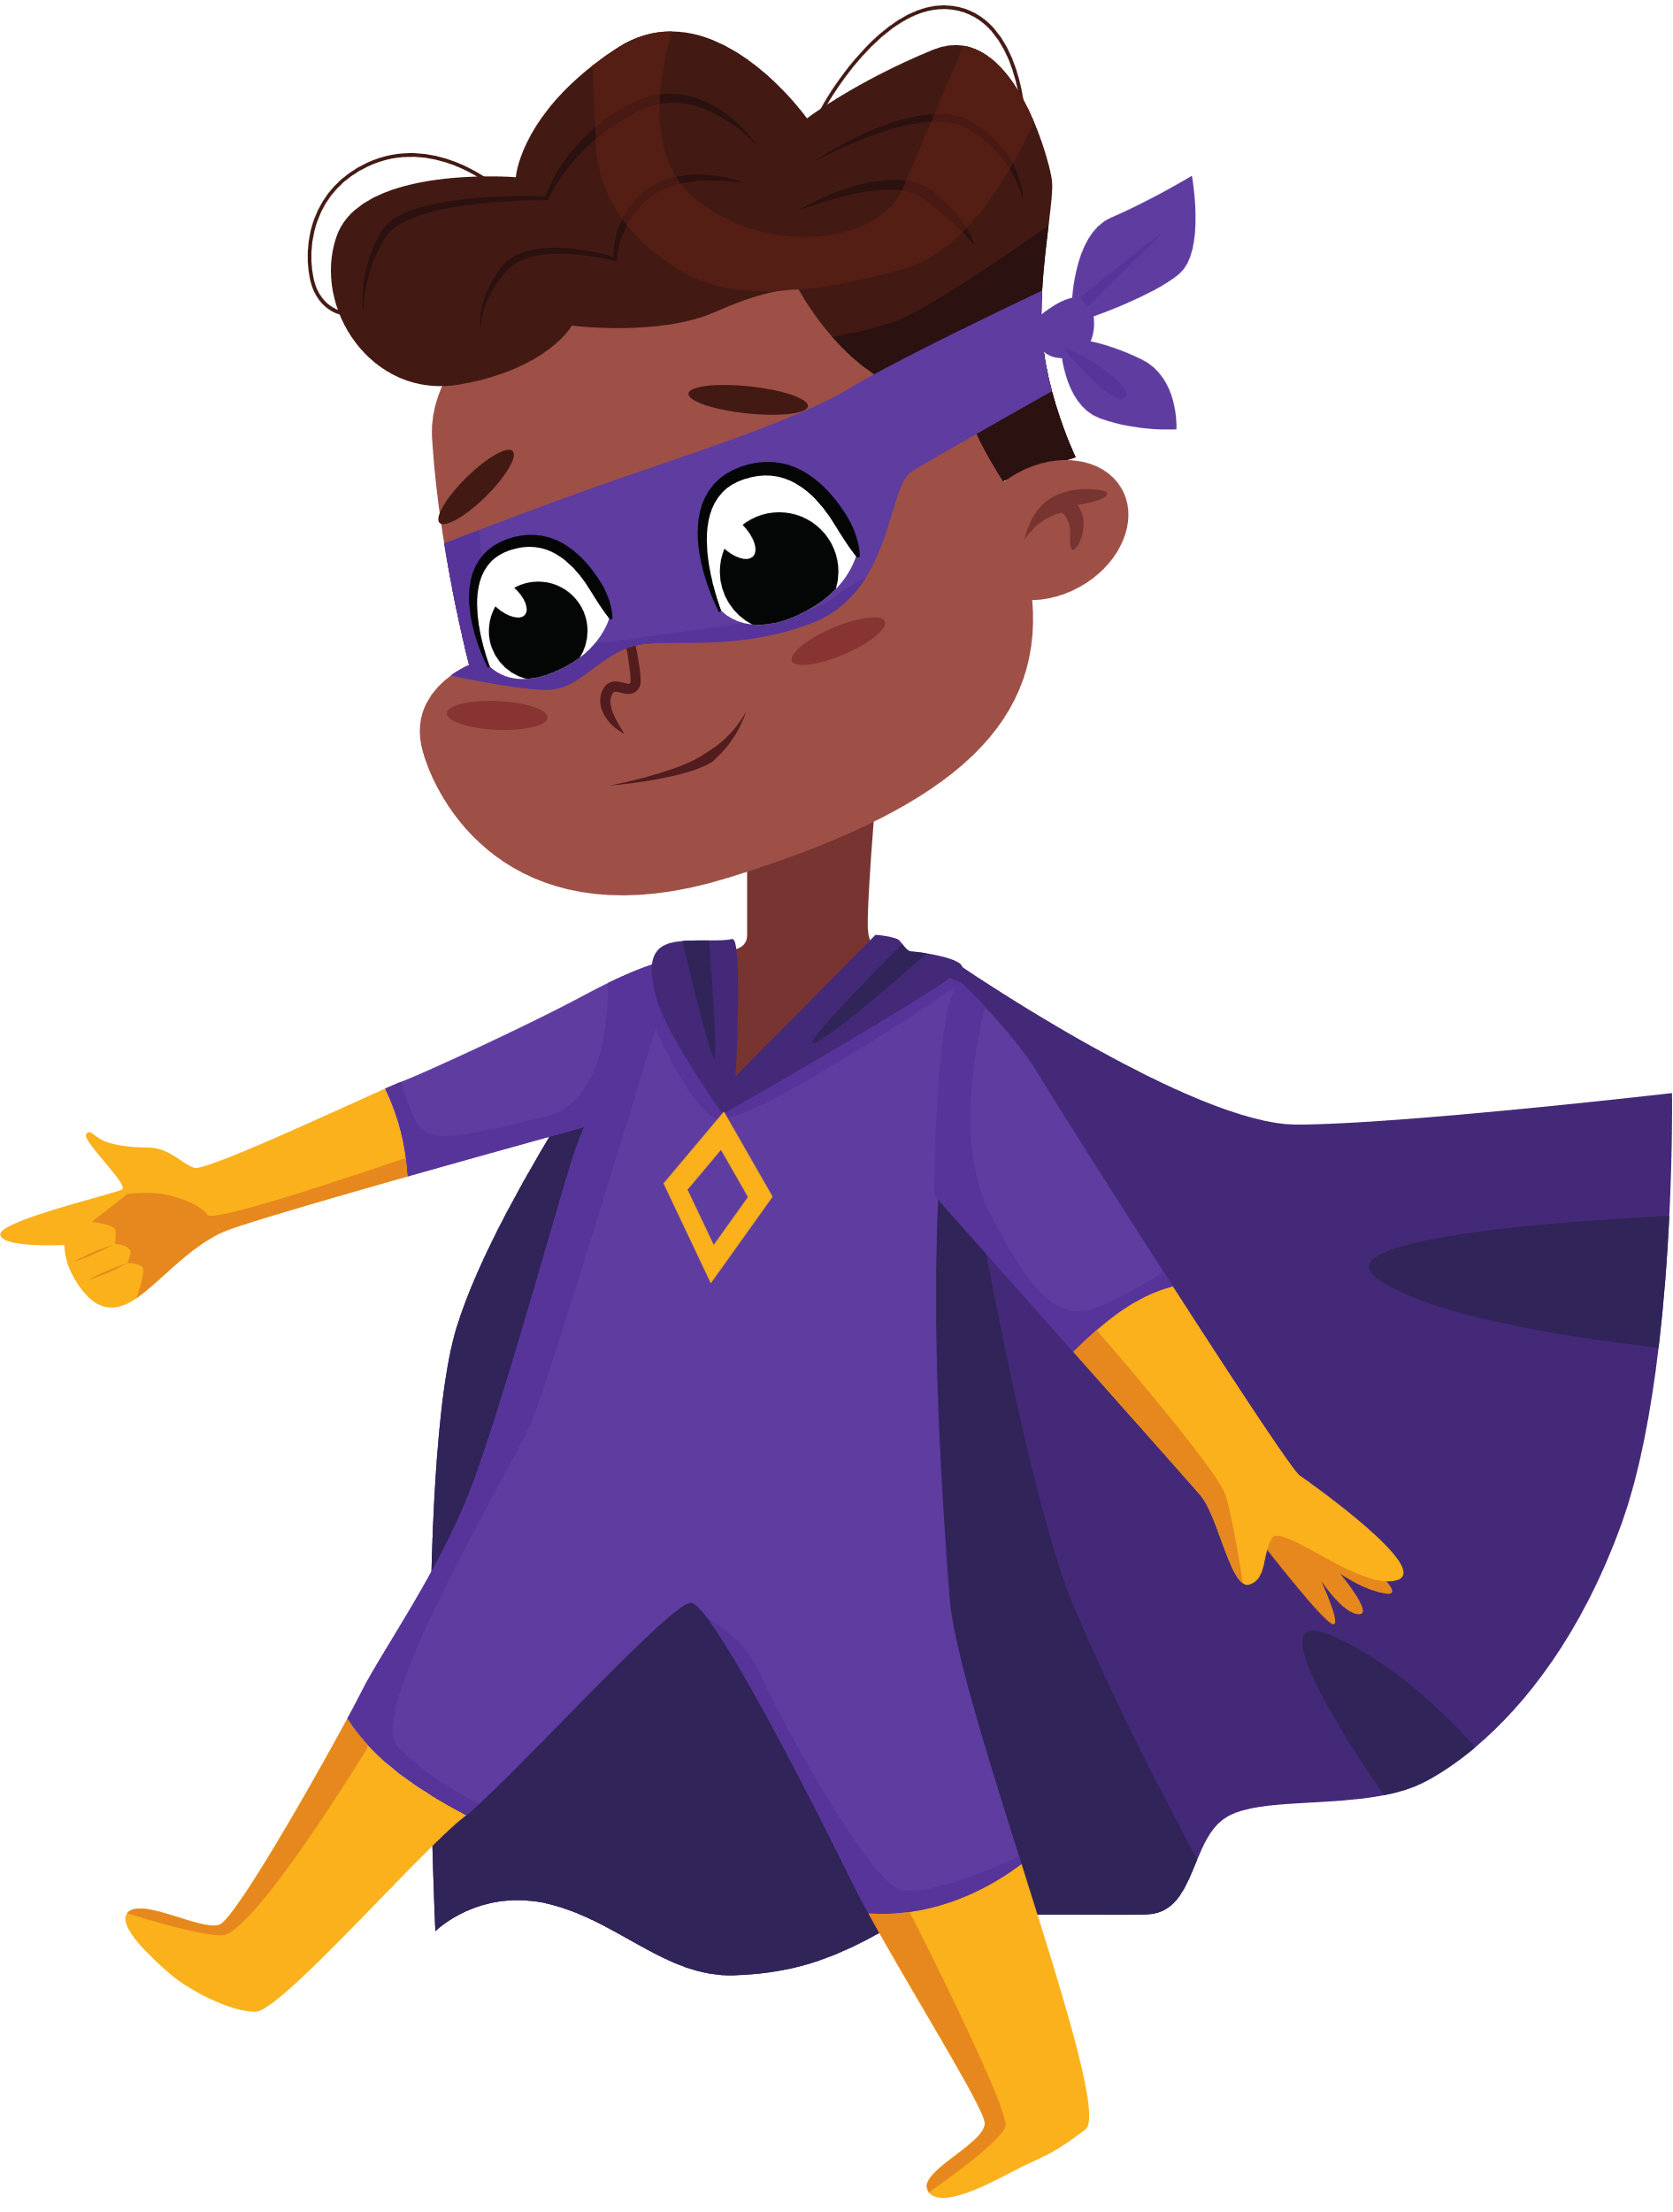
Research objectives
Main objective
To identify the specific sequential difficulties faced by children aged 6-8 with visual dyslexia and the impact of these difficulties on their academic performance.
IT20127428 | Meddaduwage P.M | TMP-23-034

Slide 16
sub objectives
Incorporate sound effects and visual feedback to help children understand sequencing.
Voice recognition methods will also track correct and incorrect responses.
Include phonics-based games and activities, such as word jumbling and puzzles, to improve learning.
Text editors and auto-correction algorithms will track individual progress.
Use text generation to predict the next letters of the alphabet.
Provide practice activities to improve the sequencing problem.
IT20127428 | Meddaduwage P.M | TMP-23-034

Slide 17



Research gap
Feature | Easy Lexia [1] | Dyslexia Baca [2] | YALU [3] | The Hope [3] | ALEXZA [4] | ARUNALU [5] | Growin’Up
Focused on letter sequencing
Sound effects and visual feedbacks
Voice recognition to track responses od sequencing
Included phonic based games in sequencing
Use of word jumbling, and puzzles focused on sequencing
Use of auto correction algorithms to track progress
Use of text generation methods to predict the next letters
Mobile solution
Support Sinhala language
IT20127428 | Meddaduwage P.M | TMP-23-034

Slide 18

Methodology
IT20127428 | Meddaduwage P.M | TMP-23-034

Slide 19
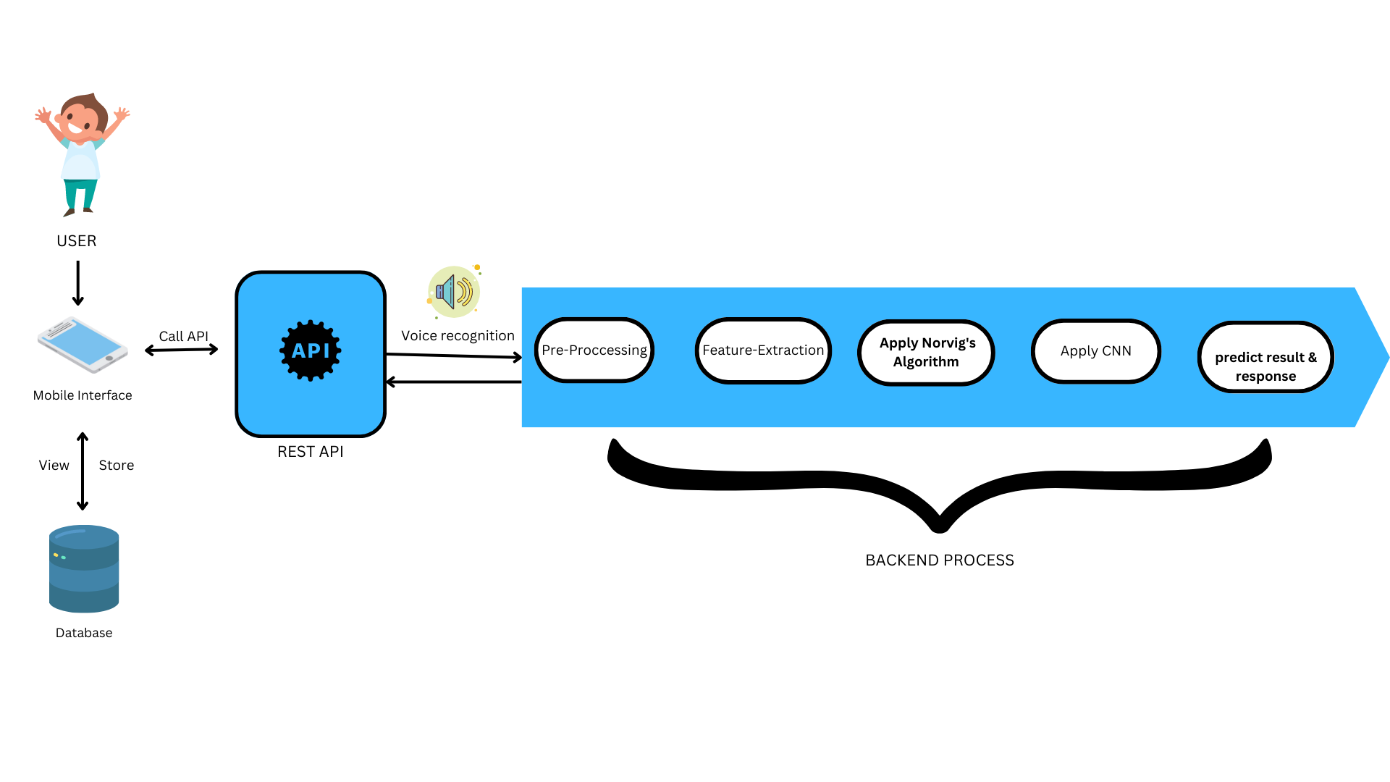
Component overview diagram
IT20127428 | Meddaduwage P.M | TMP-23-034

Slide 20






Technologies used
Multimedia technologies: HTML5, CSS, and JavaScript .
Speech recognition APIs: Google Cloud Speech-to-Text, Amazon Transcribe.
Text editors and algorithms: TinyMCE, CKEditor.
(Norvig’s correction algorithm)
Machine learning frameworks: TensorFlow .
Mobile development platforms and programming languages: Android Studio, React Native (JavaScript) ,Python.
IT20127428 | Meddaduwage P.M | TMP-23-034

Slide 21

REQUIREMENTS​
IT20127428 | Meddaduwage P.M | TMP-23-034

Slide 22
Functional REQUIREMENTS​
Have a user-friendly interface for children aged 6-8.
Assess and identify the specific sequential difficulties faced by children with visual dyslexia.
Provide targeted interventions and strategies for addressing the identified difficulties.
Include phonics-based games and activities, such as word jumbling and puzzles.
Use sound effects and visual feedback to help children understand sequencing.
Include voice recognition methods to track correct and incorrect responses.
IT20127428 | Meddaduwage P.M | TMP-23-034

Slide 23
NON-Functional REQUIREMENTS​
Application should be responsive and fast.
Application should be compatible with multiple mobile platforms, including Android and iOS.
Should be secure, with appropriate measures to protect user data and privacy.
Should be easy to install and update, with clear instructions provided to users.
Should be accessible to users with disabilities, with appropriate accessibility features implemented.
Designed with high usability and user satisfaction in mind, with regular testing and feedback from users.
IT20127428 | Meddaduwage P.M | TMP-23-034

Slide 24
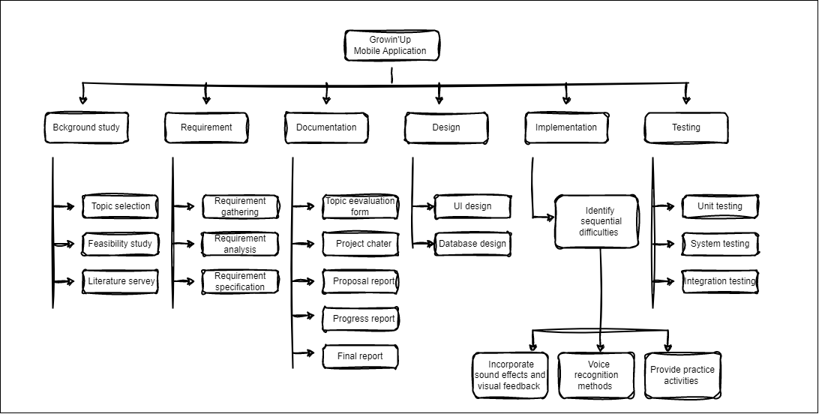
work breakdown structure​
IT20127428 | Meddaduwage P.M | TMP-23-034

Slide 25
references ​
[1] | E. S. A. G. &. D. Z. Roxani Skiada, "EasyLexia: A Mobile Application for Children with Learning," ELSEVIER, pp. 218-228, 2014.
[2] | S. M. D. a. H. Abas2, "‘Dyslexia Baca’ Mobile App - the learning ecosystem for Dyslexic Children," ReasearchGate, vol. OI:10.1109/ACSAT.2013.87, 2013.
[3] | L. C. K. W. W. W. K. R. N. S. D. T. T.C.P Kularathna, "Yalu: Computer Game Based Solution to Screen Learning Disabilities in Kids," semanticscholar, 2014.
[4] | M. C. D. H. P. R. I. W. S. Thelijjagoda, "The Hope: An Interactive Mobile Solution to Overcome the Writing, Reading and Speaking Weaknesses of Dyslexia," semanticscholar, 2019.
[5] | D. P. U. G. I. J. T. E. S. T. Sampath S. Rajapakse, "ALEXZA: A Mobile Application For Dyslexics Utilizing Artificial Intelligence And Machine Learning Concepts," semanticscholar, 2018.
[6] | S. T. S. H. T. Lakchani Sandathara, "Arunalu: Learning Ecosystem to Overcome Sinhala," ReaserachGate, 2020.
IT20127428 | Meddaduwage P.M | TMP-23-034

Slide 26
IT20142346
Sandeepa U.H.A.N
BSc(Hons) in Information Technology Specializing in Information Technology
IT20142346 | Sandeepa U.H.A.N | TMP-23-034

Slide 27

COMPONENT 02
Effects of phonological dyslexia, when learning letters, spellings and there sounds and providing solutions to overcome the learning difficulties.
IT20142346 | Sandeepa U.H.A.N | TMP-23-034

Slide 28
WHAT is phonological dyslexia?
Type of reading disorder characterized by difficulty in decoding words by their sounds or phonemes.
Caused by a deficit in the phonological processing areas of the brain, which can be the result of factors such as genetics, brain injury, or developmental abnormalities.
Individuals with phonological dyslexia may have difficulty with phonemic awareness, which is the ability to identify and manipulate individual sounds in words.
Early intervention and appropriate support can help individuals with phonological dyslexia improve their reading skills and overcome the disorder.
IT20142346 | Sandeepa U.H.A.N | TMP-23-034

Slide 29
Research problem
How does phonological dyslexia affect the learning of letters, spellings, and their sounds?
What are effective strategies for overcoming the associated learning difficulties?
Identify difficulties with phonemic awareness, making it challenging to recognize and manipulate individual sounds in words.
What are the difficulties with spelling and writing, as well as problems with understanding grammar and syntax?
IT20142346 | Sandeepa U.H.A.N | TMP-23-034

Slide 30
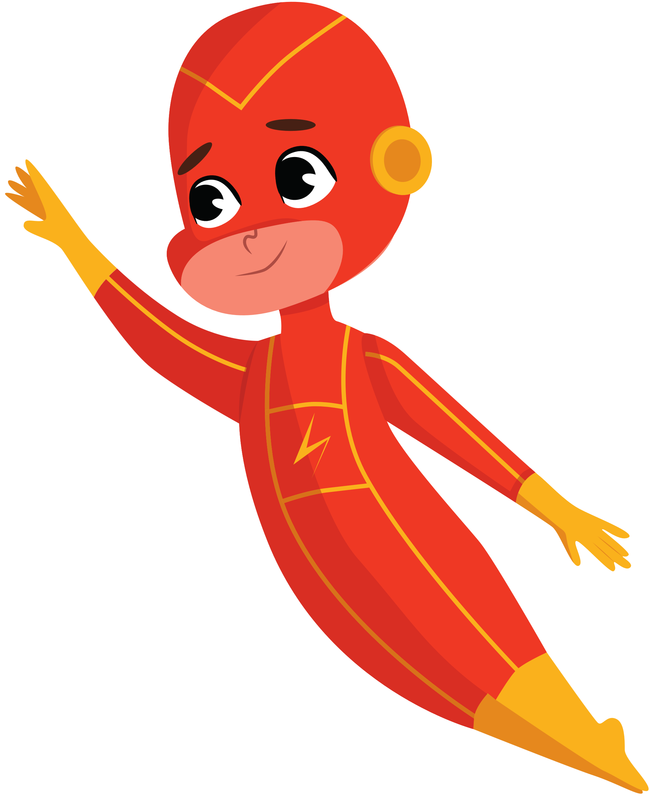
Research objectives
Main objective
Investigate the effects of phonological dyslexia on learning letters, spellings, and their sounds, and to identify effective strategies for overcoming the associated learning difficulties.
IT20142346 | Sandeepa U.H.A.N | TMP-23-034

Slide 31
sub objectives
Use audible models and voice recognition to help children learn letters and their sounds.
The app will incorporate image pre-processing to allow children to upload written letters or words for the app to check.
Will use language models in text infilling to help children learn and develop their understanding of letters.
IT20142346 | Sandeepa U.H.A.N | TMP-23-034

Slide 32
Research gap
Feature | MOBILE APPLICATION [1] | Dyslexia Baca [2] | YALU [3] | The Hope [3] | ALEXZA [4] | ARUNALU [5] | Growin’Up
Audible models and voice recognition to help children learn letters and their sounds
Image pre-processing to allow children to upload written letters or words for the app to check
language models in text infilling to help children learn and develop their understanding of letters
Mobile solution
Support Sinhala language
IT20142346 | Sandeepa U.H.A.N | TMP-23-034

Slide 33

Methodology
IT20142346 | Sandeepa U.H.A.N | TMP-23-034

Slide 34
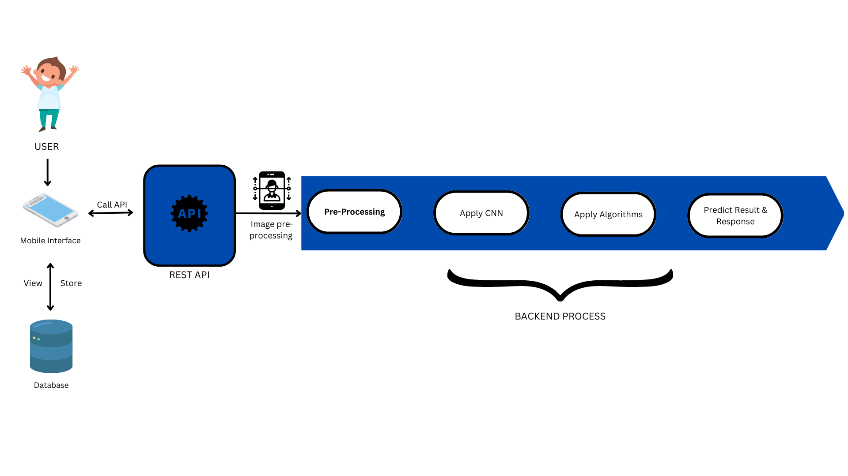
Component overview diagram
IT20142346 | Sandeepa U.H.A.N | TMP-23-034

Slide 35





Technologies used
Speech recognition APIs: Google Cloud Speech-to-Text, Amazon Transcribe.
Text-to-speech software: Google Text-to-Speech.
Image pre-processing: TensorFlow .
Natural Language Processing (NLP) libraries, such as SpaCy.
Mobile development platforms : Android Studio, React Native (JavaScript) ,Python.
IT20142346 | Sandeepa U.H.A.N | TMP-23-034

Slide 36

REQUIREMENTS​
IT20142346 | Sandeepa U.H.A.N | TMP-23-034

Slide 37
Functional REQUIREMENTS​
Have a user-friendly interface for children aged 6-8.
Provide audible models for letters and their sounds.
Allow children to record and play back their own voice saying the letters and sounds.
Should provide interactive exercises and activities to help children practice phonemic awareness and decoding skills.
Should provide progress tracking and feedback for both the child and their parents/guardians.
Should allow for customization of exercises and activities based on the child's individual needs and abilities.
IT20142346 | Sandeepa U.H.A.N | TMP-23-034

Slide 38
NON-Functional REQUIREMENTS​
Should be user-friendly and accessible to children with a variety of learning styles and abilities.
Be reliable and perform consistently across different devices and platforms.
Be secure and protect user data and privacy.
Should be designed with child safety in mind, with appropriate content and parental controls.
Should be developed using sustainable and ethical practices.
IT20142346 | Sandeepa U.H.A.N | TMP-23-034

Slide 39
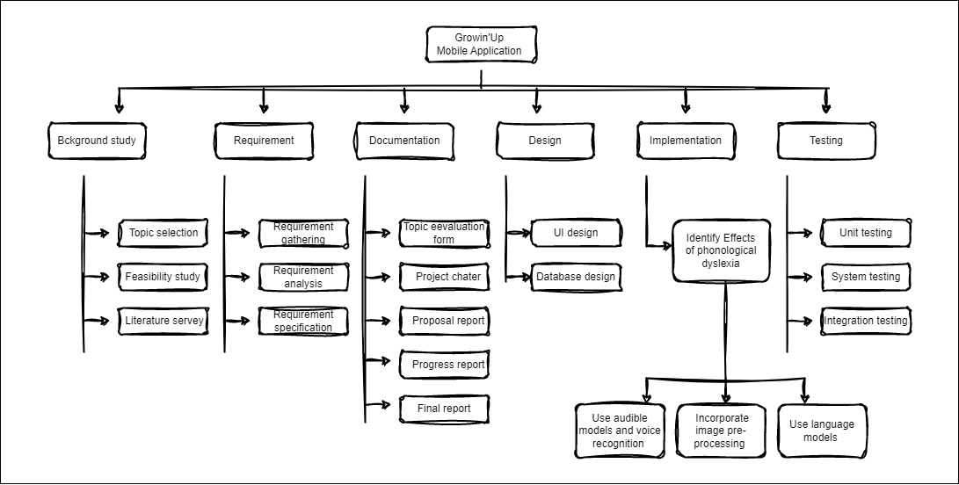
work breakdown structure​
IT20142346 | Sandeepa U.H.A.N | TMP-23-034

Slide 40
references ​
[1] | E. S. A. G. &. D. Z. Roxani Skiada, "EasyLexia: A Mobile Application for Children with Learning," ELSEVIER, pp. 218-228, 2014.
[2] | S. M. D. a. H. Abas2, "‘Dyslexia Baca’ Mobile App - the learning ecosystem for Dyslexic Children," ReasearchGate, vol. OI:10.1109/ACSAT.2013.87, 2013.
[3] | L. C. K. W. W. W. K. R. N. S. D. T. T.C.P Kularathna, "Yalu: Computer Game Based Solution to Screen Learning Disabilities in Kids," semanticscholar, 2014.
[4] | M. C. D. H. P. R. I. W. S. Thelijjagoda, "The Hope: An Interactive Mobile Solution to Overcome the Writing, Reading and Speaking Weaknesses of Dyslexia," semanticscholar, 2019.
[5] | D. P. U. G. I. J. T. E. S. T. Sampath S. Rajapakse, "ALEXZA: A Mobile Application For Dyslexics Utilizing Artificial Intelligence And Machine Learning Concepts," semanticscholar, 2018.
[6] | S. T. S. H. T. Lakchani Sandathara, "Arunalu: Learning Ecosystem to Overcome Sinhala," ReaserachGate, 2020.
IT20142346 | Sandeepa U.H.A.N | TMP-23-034

Slide 41
IT20139094
L.T.N Liyanage
BSc(Hons) in Information Technology Specializing in Information Technology

Slide 42

COMPONENT 03
Identifying the number learning difficulties faced by
dyslexic students with providing the possible
solutions to overcome them.
IT20139094 | Liyanage L.T.N | TMP-23-034

Slide 43
WHAT is Dyslexia for Numbers ?
Dyslexia for numbers, also known as dyscalculia, is a learning problem that makes it difficult for someone to understand and work with math and numbers.
Dyscalculia can impact a student's ability to do basic math, understand complex math concepts, and interpret visual representations of numerical information like graphs and charts.
Dyscalculia is often associated with other learning difficulties, such as dyslexia and attention deficit hyperactivity disorder (ADHD)
Early identification and intervention are important for students with dyscalculia. With appropriate support and accommodations, students with dyscalculia can learn to manage their difficulties and achieve success in mathematics and other areas of life.

Slide 44
Research problem
Identify What are the difficulties faced by children aged 6-8 with Dyslexia for numbers ?
What are the problems that can happen when they get older?
How can we help these students in serious situation.
What role do technology-based interventions play in supporting dyslexic students' number learning, and how effective are these interventions compared to traditional teaching methods?
Can a mobile application help them to overcome this problem?
IT20139094 | Liyanage L.T.N | TMP-23-034

Slide 45

Research objective
Identify and describe specific difficulties related to dyscalculia.
Evaluate the success of different intervention and instructional strategies.
Develop and implement comprehensive assessment and screening protocols.
Investigate new technological tools to support number learning.
Examine the social and emotional impact of dyscalculia.
Address the learning challenges faced by students with dyscalculia.
Assist educators and researchers in better understanding dyscalculia.
Create effective interventions to support the learning and achievement of dyscalculic children.
IT20139094 | Liyanage L.T.N | TMP-23-034

Slide 46
sub objectives
Automatic Speech Recognition to create a speech-to-text calculator by which a child can easily mathematical operations.
Design of Student Assessment Model Based on Intelligence Quotient Using Machine Learning.
Creating fun activities and games to improve the logical thinking of the children.
provide a personalized dashboard to track their progress over time.

Slide 47
Research gap
Feature | MOBILE APPLICATION [1] | Dyslexia Baca [2] | YALU [3] | The Hope [3] | ALEXZA [4] | ARUNALU [5] | Growin’Up
Automatic Speech Recognition to create a speech to text calculator by which a child can easily mathematical operations.
Design of Student Assessment Model Based on Intelligence Quotient Using Machine Learning.
Design of Student Assessment Model Based on Intelligence Quotient Using Machine Learning.
Mobile solution
Support Sinhala language
IT20139094 | Liyanage L.T.N | TMP-23-034

Slide 48

Methodology
IT20139094 | Liyanage L.T.N | TMP-23-034

Slide 49
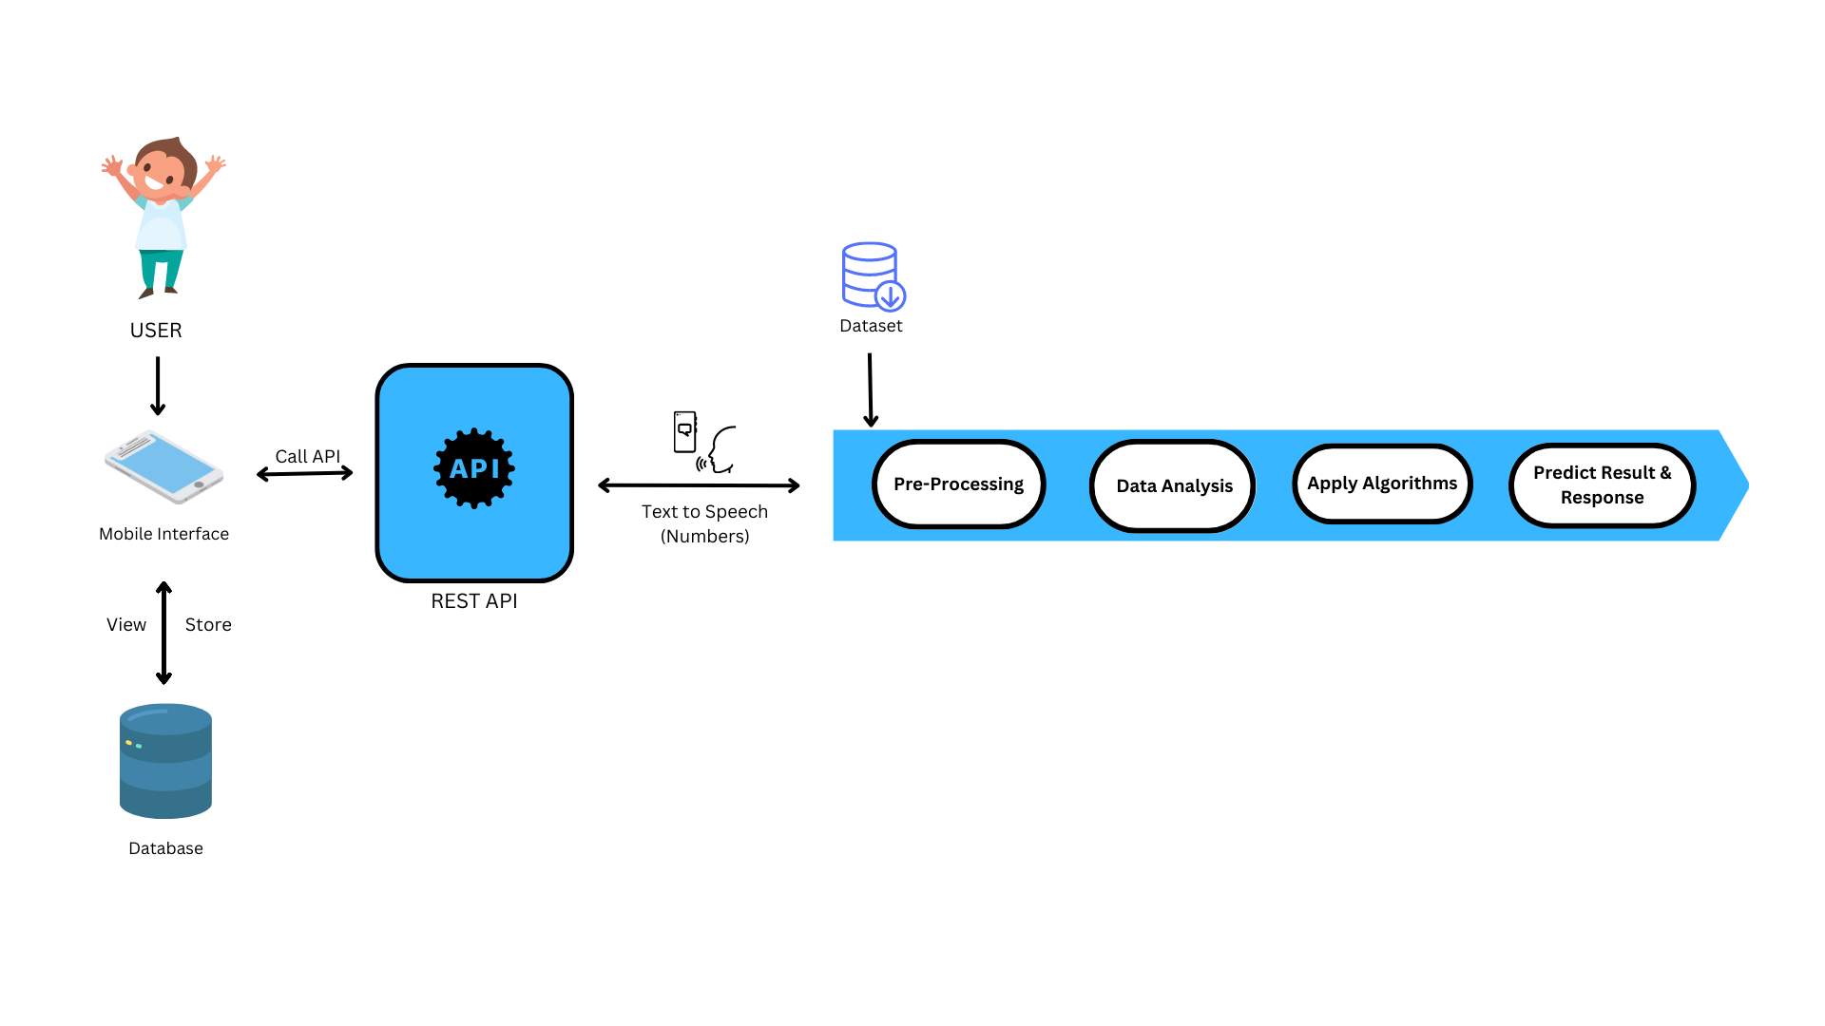
Component overview diagram
IT20139094 | Liyanage L.T.N | TMP-23-034

Slide 50

Technologies used
Mobile development platforms:
Android Studio, React Native (JavaScript), Python.
Text-to-speech (TTS) :
Google Text-to-Speech, or Microsoft Speech API
Speech recognition software or API :
Google Speech-to-Text or Microsoft Azure Speech Services
Audio processing libraries :
PyAudio or Librosa
Image pre-processing :
TensorFlow .
IT20139094 | Liyanage L.T.N | TMP-23-034

Slide 51

REQUIREMENTS​
IT20139094 | Liyanage L.T.N | TMP-23-034

Slide 52
Functional REQUIREMENTS​
Simple enough to be accessible by anyone of any age.
Have a user-friendly interface for children aged 6-8.
They will can do many mathematical operations with this calculator.
Creating fun activities and little games, and they can track their progress
provide a personalized dashboard to track their progress over time.
IT20139094 | Liyanage L.T.N | TMP-23-034

Slide 53
NON-Functional REQUIREMENTS​
The system should be user-friendly.
Maintainability.
Accuracy and efficiency of the system.
Availability.
Be secure and protect user data and privacy.
IT20139094 | Liyanage L.T.N | TMP-23-034

Slide 54
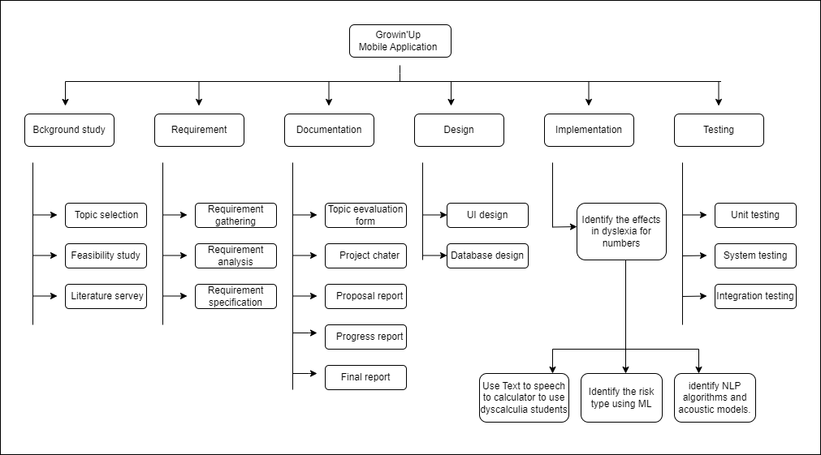
work breakdown structure​
IT20139094 | Liyanage L.T.N | TMP-23-034

Slide 55
references ​
E. S. A. G. &. D. Z. Roxani Skiada, "EasyLexia: A Mobile Application for Children with Learning," ELSEVIER, pp. 218-228, 2014.
S. M. D. a. H. Abas2, "‘Dyslexia Baca’ Mobile App – the learning ecosystem for Dyslexic Children, " Reasearch Gate, vol. OI:10.1109/ACSAT.2013.87, 2013.
L. C. K. W. W. W. K. R. N. S. D. T. T.C.P Kularathna, "Yalu: Computer Game Based Solution to Screen Learning Disabilities in Kids," semantic scholar, 2014.
M. C. D. H. P. R. I. W. S. Thelijjagoda, "The Hope: An Interactive Mobile Solution to Overcome the Writing, Reading and Speaking Weaknesses of Dyslexia," semanticscholar, 2019.
D. P. U. G. I. J. T. E. S. T. Sampath S. Rajapakse, "ALEXZA: A Mobile Application For Dyslexics Utilizing Artificial Intelligence And Machine Learning Concepts," semanticscholar, 2018.
S. T. S. H. T. Lakchani Sandathara, "Arunalu: Learning Ecosystem to Overcome Sinhala," ReaserachGate, 2020.
IT20139094 | Liyanage L.T.N | TMP-23-034

Slide 56
IT20088828
E.N.D.S. Elamaldeniya
BSc(Hons) in Information Technology Specializing in Information Technology

Slide 57
COMPONENT 04
Researching on rapid naming dyslexia and focusing on reading disabilities faced by dyslexic students.
IT20088828 | Elamaldeniya E.N.D.S. | TMP-23-034

Slide 58
WHAT is RAPID NAMING dyslexia?
Rapid naming dyslexia is a specific type of dyslexia that affects a person's ability to quickly and accurately name familiar objects, letters, or numbers.
People with rapid naming dyslexia often struggle with reading fluency and may have difficulty recognizing and decoding words.
Rapid naming dyslexia is often diagnosed through a series of cognitive and reading tests that assess an individual's ability to recognize and process visual information.

Slide 59
Research problem
What specific reading difficulties are faced by dyslexic students with rapid naming dyslexia?
How does rapid naming dyslexia impact the reading speed and accuracy of dyslexic students?
What effective interventions can be used to improve the reading skills of dyslexic students with rapid naming dyslexia?
How can assistive technology be used to support the reading skills of dyslexic students with rapid naming dyslexia?
IT20088828 | Elamaldeniya E.N.D.S. | TMP-23-034

Slide 60
Research objective
To investigate the relationship between rapid naming ability and reading fluency in individuals with rapid naming dyslexia, and to determine the effectiveness of visual processing interventions in improving rapid naming ability and reading outcomes in this population.
IT20088828 | Elamaldeniya E.N.D.S. | TMP-23-034

Slide 61
sub objectives
Will use Audible to enable listening and reading of text, with voice recognition to identify phrases.
Will feature adjustable audio playback speed settings and contextual text highlighting.
A quiz mode, utilizing voice recognition to test comprehension of the text, will also be included.
The app will provide a personalized dashboard to track progress over time.
IT20088828 | Elamaldeniya E.N.D.S. | TMP-23-034

Slide 62
Research gap
Feature | MOBILE APPLICATION [1] | Dyslexia Baca [2] | YALU [3] | The Hope [3] | ALEXZA [4] | ARUNALU [5] | Growin’Up
Voice recognition technology designed for children to aid in their reading abilities.
Monitor progress over a period of time.
Quiz mode that utilizes both voice recognition and written responses
Mobile solution
Support Sinhala language
IT20088828 | Elamaldeniya E.N.D.S. | TMP-23-034

Slide 63
Methodology
IT20088828 | Elamaldeniya E.N.D.S. | TMP-23-034

Slide 64
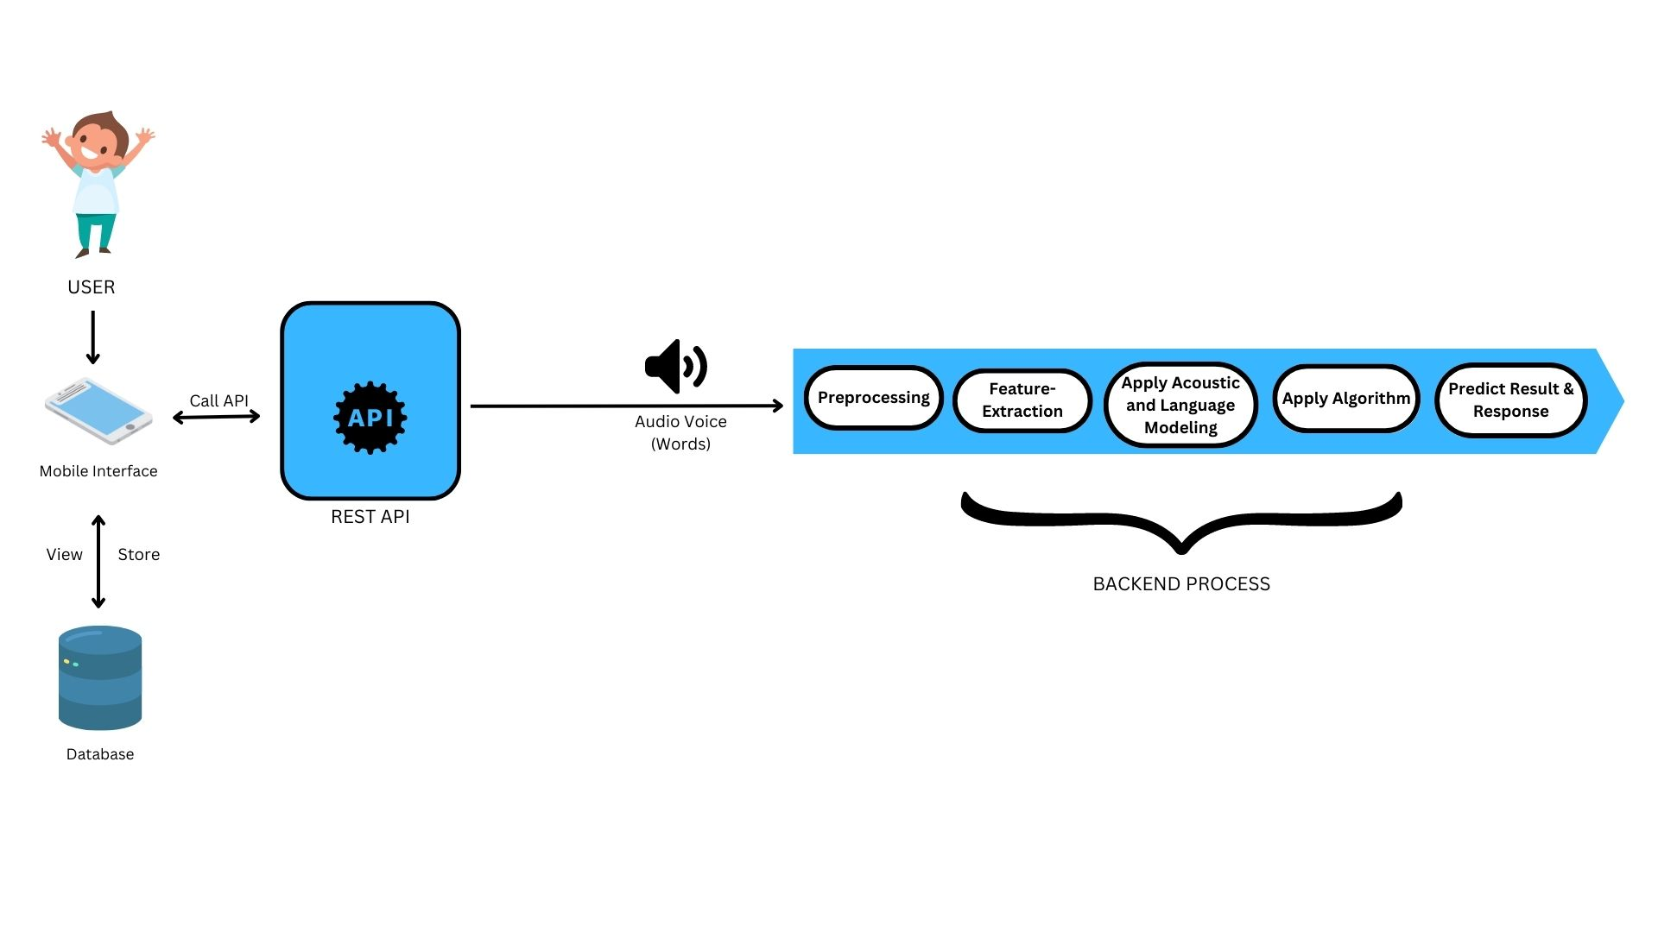
Component overview diagram
IT20088828 | Elamaldeniya E.N.D.S. | TMP-23-034

Slide 65



Technologies used
Text-to-speech (TTS) : Google Text-to-Speech, or Microsoft Speech API
Speech recognition software or API :Google Speech-to-Text or Microsoft Azure Speech Services
Audio processing libraries such as PyAudio or Librosa
Text processing libraries such as NLTK or spaCy
Mobile development platforms: Android Studio, React Native (JavaScript) , Python.
IT20088828 | Elamaldeniya E.N.D.S. | TMP-23-034

Slide 66
REQUIREMENTS​

Slide 67
Functional REQUIREMENTS​
Have a user-friendly interface for children aged 6-8.
should allow users to listen to text in different playback speeds, such as 0.5x, 1x, 1.25x, 1.5x, 2x, etc.
should use voice recognition to identify specific phrases in the text and provide relevant information about them.
should provide a dashboard that allows users to track their progress over time, including reading and listening times and quiz scores.

Slide 68
NON-Functional REQUIREMENTS​
Accuracy and efficiency of the system.
The system should be user-friendly.
Maintainability.
Availability.

Slide 69
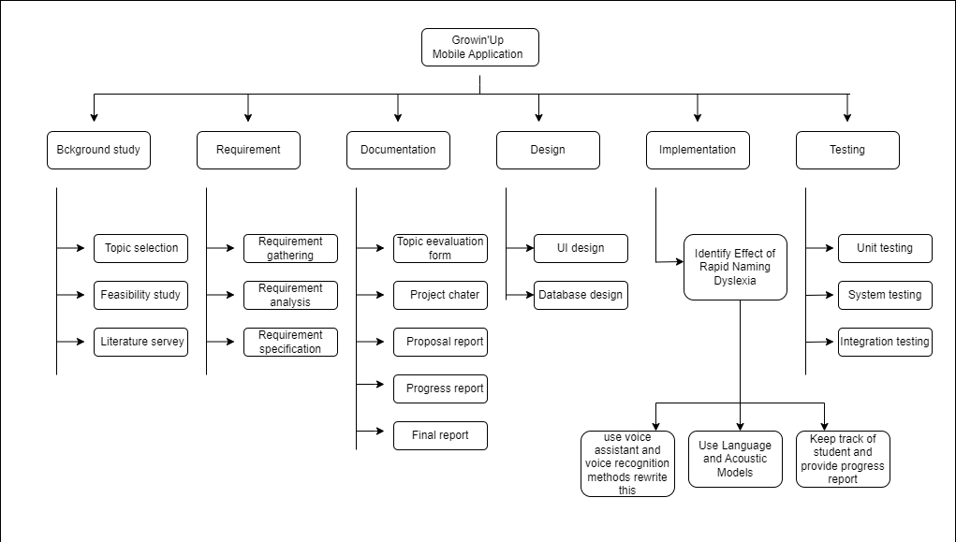
work breakdown structure​

Slide 70
references ​
[1] ​ | E. S. A. G. &. D. Z. Roxani Skiada, "EasyLexia: A Mobile Application for Children with Learning," ELSEVIER, pp. 218-228, 2014. ​
[2] ​ | S. M. D. a. H. Abas2, "‘Dyslexia Baca’ Mobile App - the learning ecosystem for Dyslexic Children," ReasearchGate, vol. OI:10.1109/ACSAT.2013.87, 2013. ​
[3] ​ | L. C. K. W. W. W. K. R. N. S. D. T. T.C.P Kularathna, "Yalu: Computer Game Based Solution to Screen Learning Disabilities in Kids," semanticscholar, 2014. ​
[4] ​ | M. C. D. H. P. R. I. W. S. Thelijjagoda, "The Hope: An Interactive Mobile Solution to Overcome the Writing, Reading and Speaking Weaknesses of Dyslexia," semanticscholar, 2019. ​
[5] ​ | D. P. U. G. I. J. T. E. S. T. Sampath S. Rajapakse, "ALEXZA: A Mobile Application For Dyslexics Utilizing Artificial Intelligence And Machine Learning Concepts," semanticscholar, 2018. ​
[6] ​ | S. T. S. H. T. Lakchani Sandathara, "Arunalu: Learning Ecosystem to Overcome Sinhala," ReaserachGate, 2020. ​

Slide 71
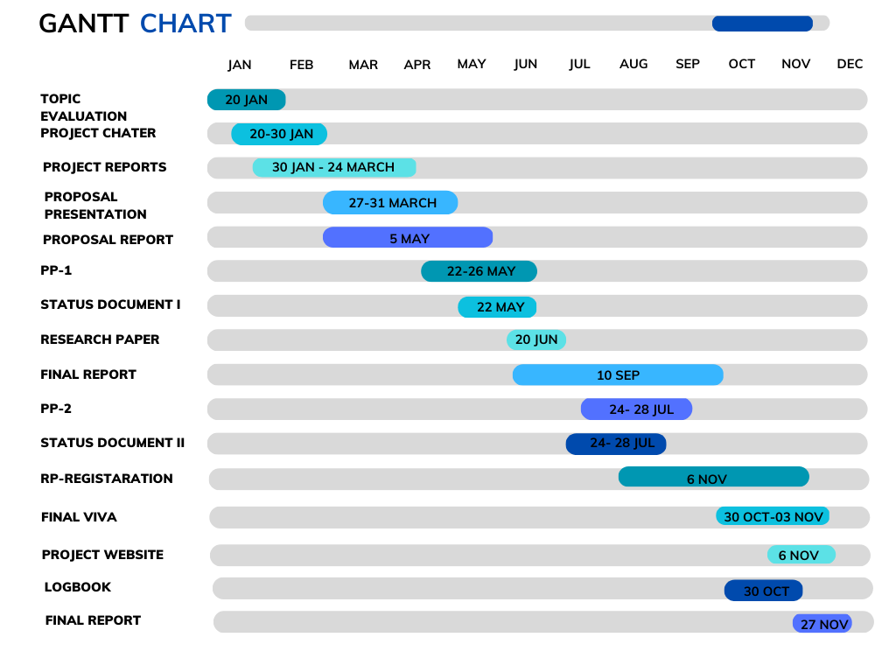
gantt chart

Slide 72
Commercialization aspects
For schools Rs.1000
Monthly Subscription Rs.1500
Premium Subscription RS.2000
Free 3 Month Trail Subscription
Social Media Commercialization

Slide 73
budget
Component | Amount (LKR) | Amount (USD)
Direct Cost
Printing | 2,000 | 6
Travelling | 2,000 | 6
Indirect Cost
Wi-Fi/Mobile Data | 10,000 | 30
Electricity | 5,000 | 15
Transport | 2,000 | 6
Web Hosting | 5,000 | 15
Total | 26,000 | 78

Slide 74
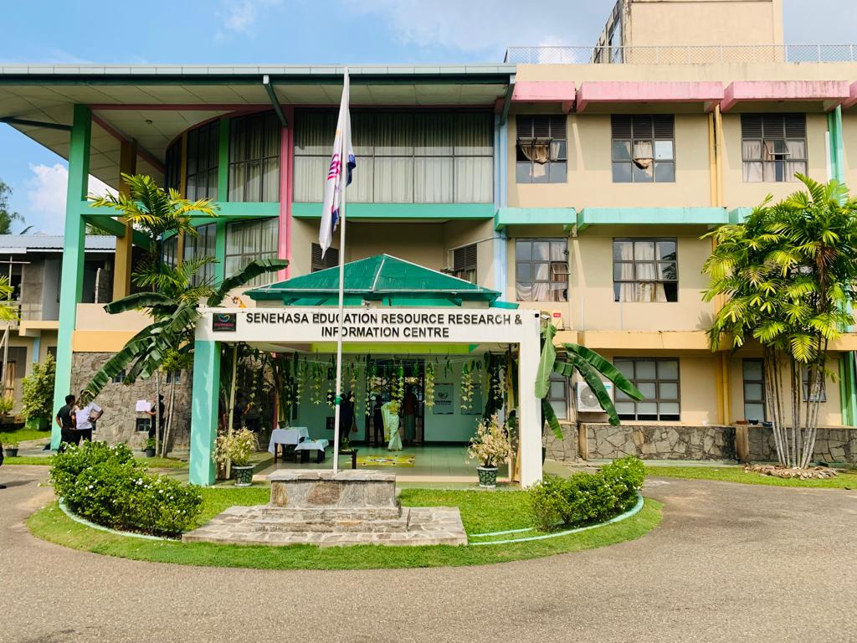
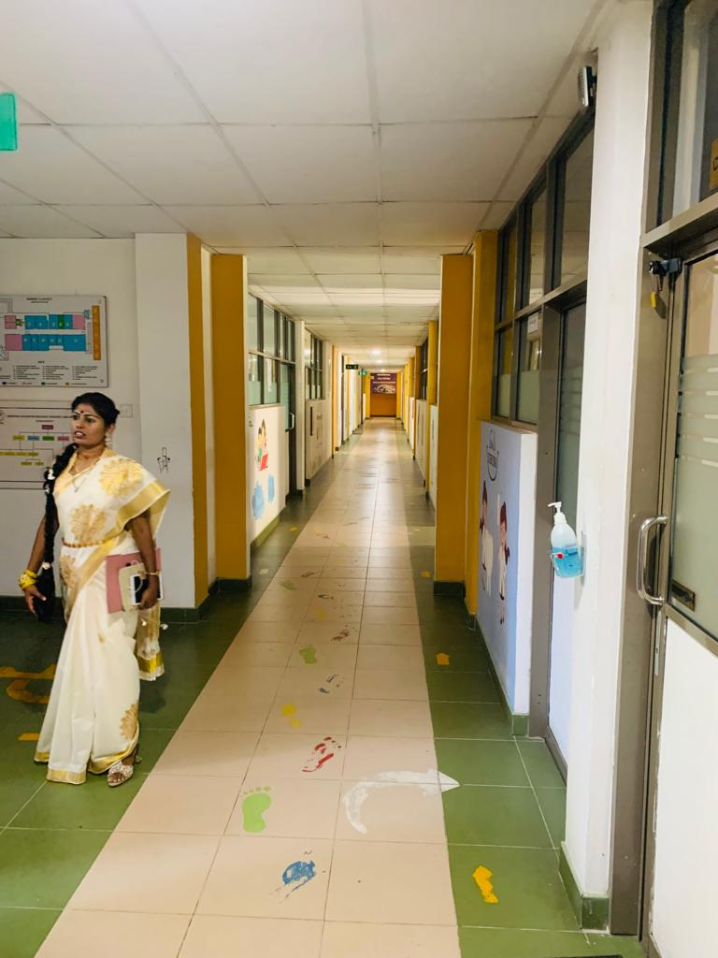
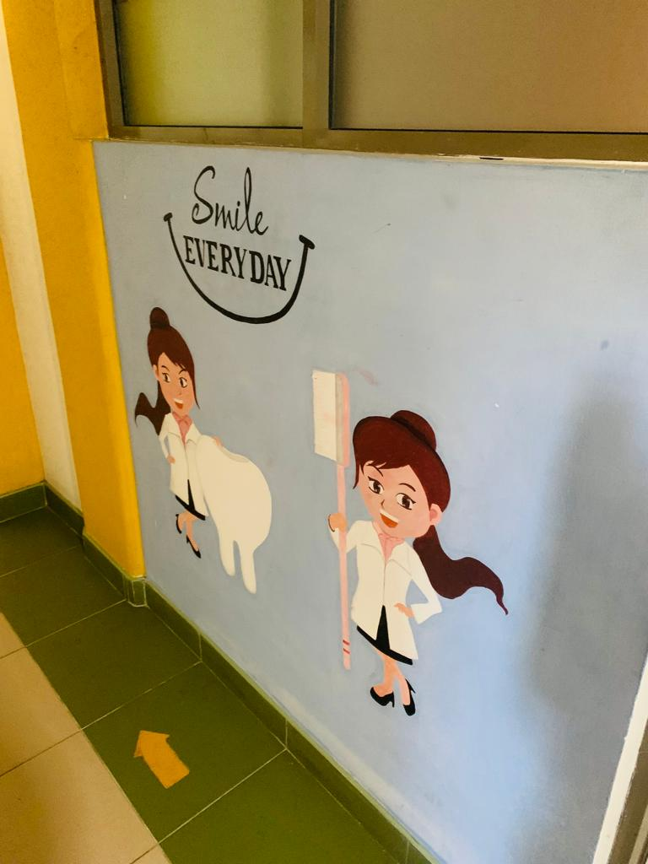
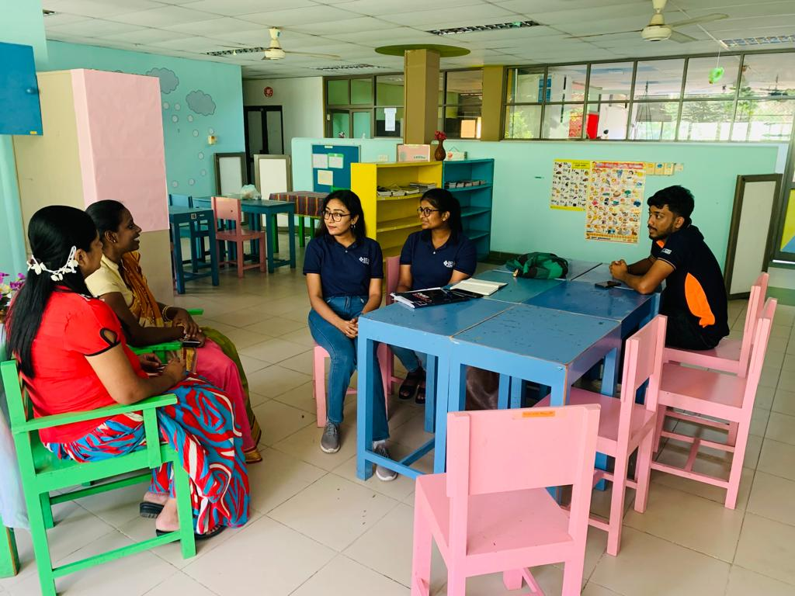
appendix
A visit to the Narahenpita Special Education Center to Collect the Necessary Data.

Slide 75
ANY QUESTIONS?

Slide 76

THANK YOU FOR LISTENING!

